Slide 1
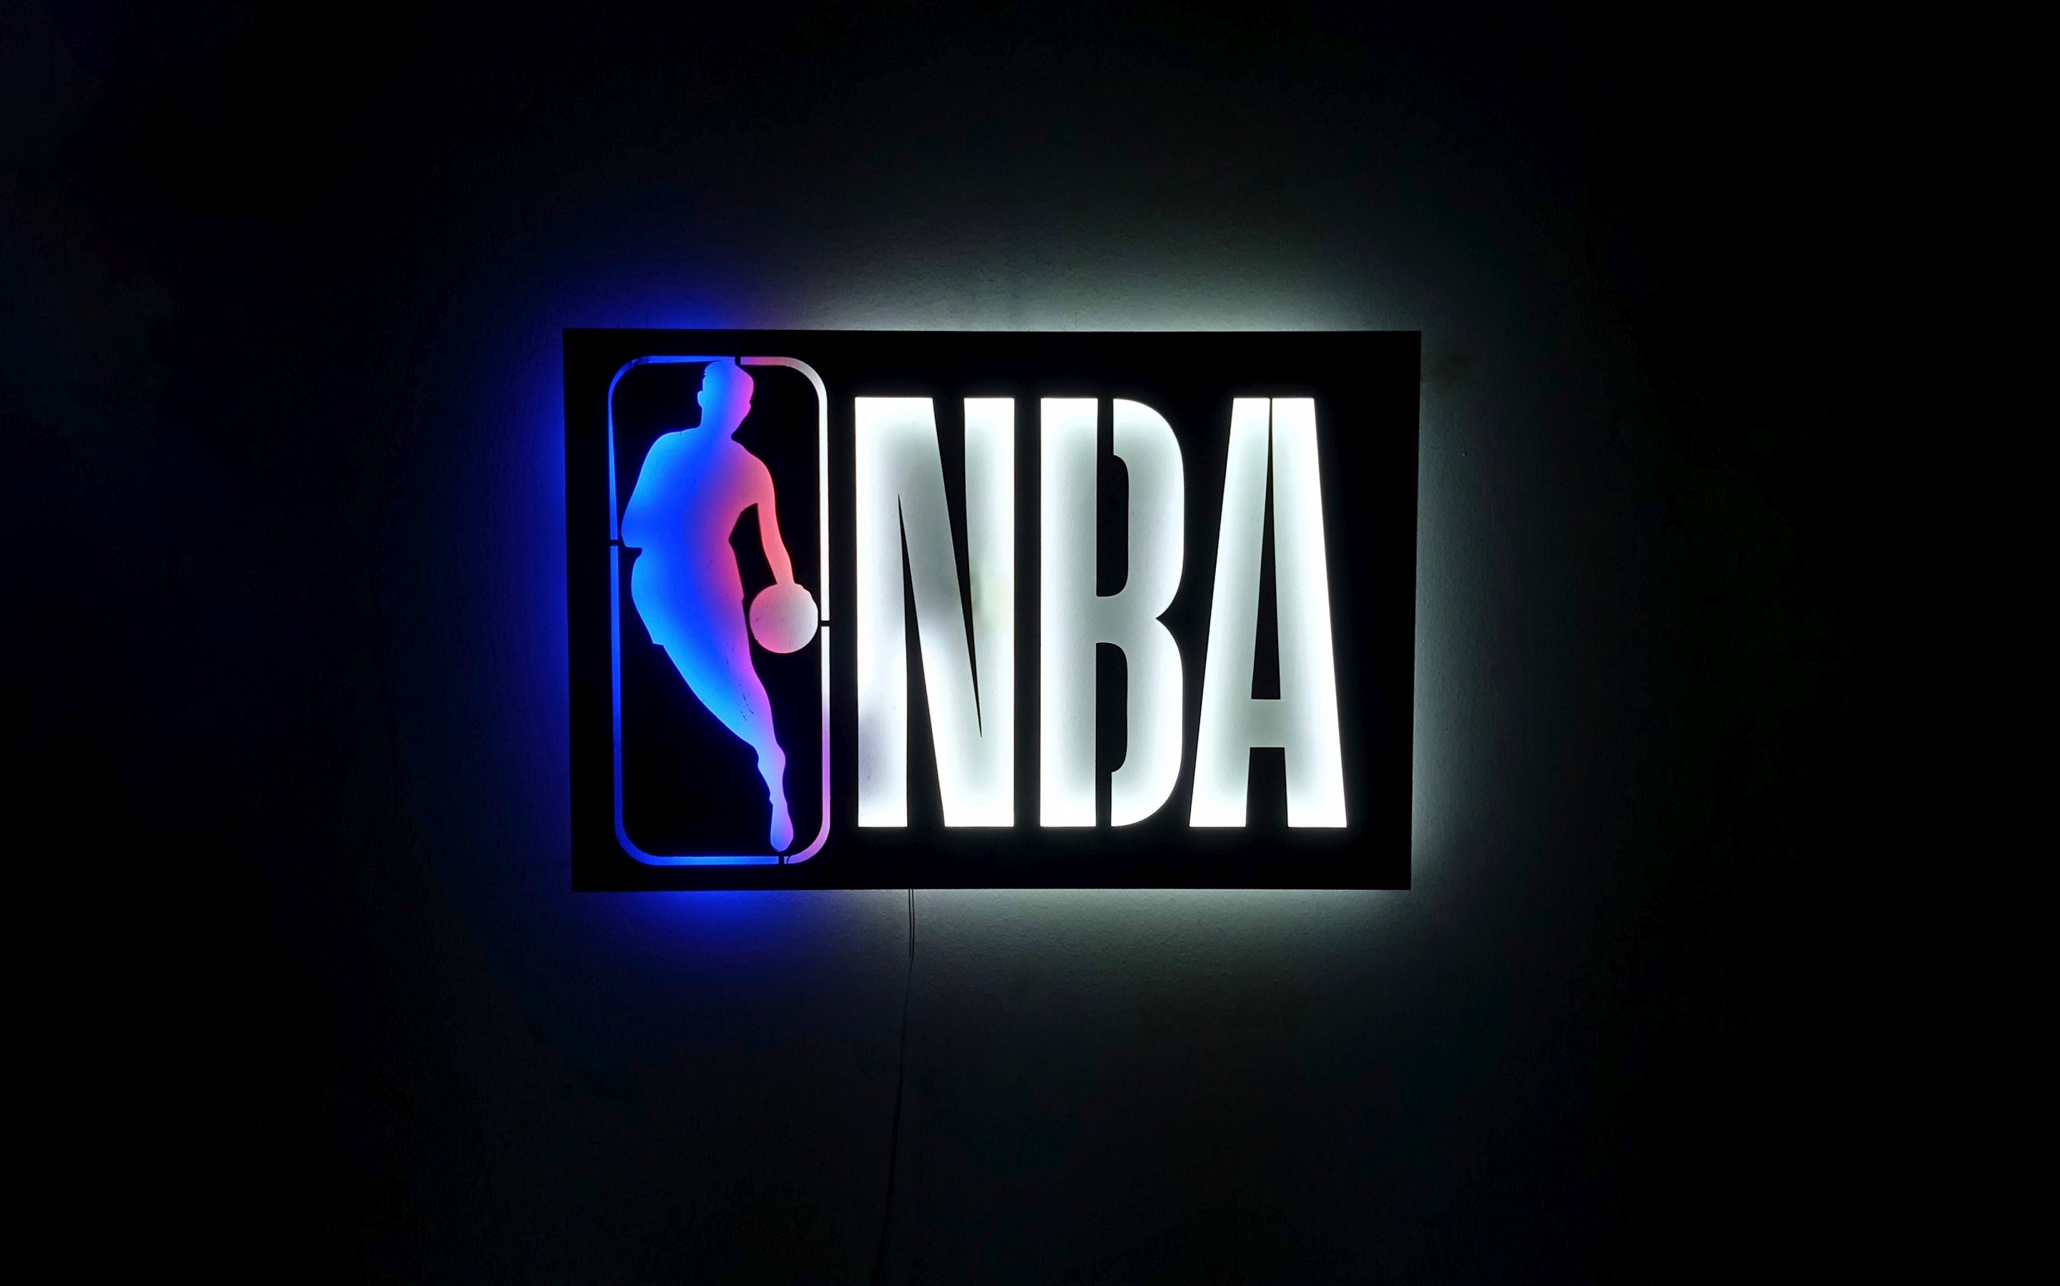
NBA Offseason Grades: Team Results
2024-2025 Offseason Analysis
David Welsh
October 21st ,2025

Slide 2
2024-2025 NBA OFFSEASON GRADES
Rank | Team | Grade | Final Score | Rank | Team | Grade | Final Score
1 | LAC | A+ | 95.50 | 16 | MIN | B- | 4.84
2 | OKC | A+ | 53.73 | 17 | CLE | B- | 4.08
3 | DAL | A | 49.66 | 18 | TOR | B- | 1.76
4 | ATL | A | 44.72 | 19 | PHO | C+ | -2.66
5 | SAC | A | 44.00 | 20 | BRK | C+ | -3.66
6 | NYK | A | 42.38 | 21 | SAS | C+ | -4.68
7 | DEN | A | 41.51 | 22 | WAS | C | -14.83
8 | HOU | A | 36.93 | 23 | PHI | D | -26.05
9 | GSW | A- | 34.83 | 24 | CHO | D | -26.14
10 | ORL | A- | 32.06 | 25 | MIL | D | -26.28
11 | POR | A- | 30.02 | 26 | DET | D | -26.51
12 | LAL | A- | 25.08 | 27 | NOP | D | -31.25
13 | MEM | B | 13.17 | 28 | IND | D | -39.41
14 | CHI | B | 6.25 | 29 | UTA | F | -58.67
15 | MIA | B | 6.16 | 30 | BOS | F | -67.95

Slide 3
Presentation structure
Teams ordered by their offseason grade ranking
split by conference
Grade: X | Rank: X | Conference rank: x
Grade: offseason grade calculated by the Python model
Rank: overall rank out of the 30 teams
Conference rank: rank out of the 15 conference teams

Slide 4

Atlanta Hawks
Grade: A | Rank: #4 | Eastern Conference Rank: #1
The Hawks' biggest moves were giving Trae Young a legitimate floor-stretching center in Kristaps Porzingis and adding 3&D guard Nickeil Alexander-Walker. They capped off the offseason by extending DPOY candidate Dyson Daniels. After finishing as a play-in team last season, the Hawks hope to be in the playoff mix in the East.

Slide 5

New York knicks
Grade: A | Rank: #6 | Eastern Conference Rank: #2
The Knicks added more depth, signing Jordan Clarkson and Guerschon Yabusele. They also extended the contract of starting forward Mikal Bridges. Coming off an Eastern Conference Finals appearance last year, New York remains a contender in the East.

Slide 6

Orlando magic
Grade: A- | Rank: #10 | Eastern Conference Rank: #3
The Magic acquired Desmond Bane from the Grizzlies in one of the most aggressive moves of the offseason, trading multiple 1st round picks. They also signed point guard Tyus Jones and extended Paolo Banchero. Orlando hopes to improve offensively and become a threat in the East.

Slide 7

Chicago Bulls
Grade: B | Rank: #14 | Eastern Conference Rank: #4
It was a quiet offseason in Chicago; the Bulls traded Lonzo Ball for Isaac Okoro. With Josh Giddey re-signed and a focus on internal development, Chicago is banking on Coby White, Matas Buzelis, and Ayo Dosunmu to take another step. A playoff push will depend on the growth of their young core.

Slide 8

Miami heat
Grade: B | Rank: #15 | Eastern Conference Rank: #5
The Heat added scoring by acquiring Norman Powell while extending Nikola Jovic and re-signing Davion Mitchell. Miami will need Tyler Herro to recover quickly to maximize its chances in the Eastern Conference.

Slide 9

Cleveland cavaliers
Grade: B- | Rank: #17 | Eastern Conference Rank: #6
The Cavaliers worked smartly within financial limits. They added versatility with Lonzo Ball and frontcourt depth in Larry Nance Jr and Thomas Bryant. They also re-signed sharpshooter Sam Merrill. Despite early injuries, Cleveland remains a legit contender, with hope for better injury luck come April.

Slide 10

Toronto raptors
Grade: B- | Rank: #18 | Eastern Conference Rank: #7
The Raptors had a decent offseason, extending Jakob Poeltl and adding young talent in Collin Murray-Boyles and Alijah Martin. While their ceiling is uncertain, Toronto hopes to compete for a playoff spot and see the impact of a full season with Brandon Ingram on the roster.

Slide 11

Brooklyn Nets
Grade: C+ | Rank: #20 | Eastern Conference Rank: #8
The Nets drafted 5 players in the first round, which may be a first in the NBA. I’m expecting heavy experimentation this year, with Michael Porter Jr. and Cam Thomas putting up any kind of shots they want. How many of Brooklyn’s first-rounders will pan out?

Slide 12

Washington wizards
Grade: D | Rank: #22 | Eastern Conference Rank: #9
The Wizards are on a long-term timeline. Bilal Coulibaly is injured, and much of the roster is young and unproven. Washington won just 18 games last season; hopefully, Tre Johnson can get settled as the dynamic scorer he was in college.

Slide 13

Philadelphia 76ers
Grade: D | Rank: #23| Eastern Conference Rank: #10
The 76ers drafted VJ Edgecombe, who is projected to start and help the team immediately. As always, health remains the limiting factor for Philadelphia. If Joel Embiid, Paul George, and Jared McCain are all at full strength, they should improve significantly after a disappointing 24-win season.

Slide 14

Charlotte hornets
Grade: D | Rank: #24| Eastern Conference Rank: #11
The Hornets added offense with Kon Knueppel and Collin Sexton, but lost their rim protector after trading away Mark Williams. The offense looks fun with Lamelo Ball healthy, but the lack of proven interior defense and perimeter stoppers raises serious concerns about their ability to compete in the East.

Slide 15

Milwaukee bucks
Grade: D | Rank: #25 | Eastern Conference Rank: #12
The Bucks lost Damian Lillard and Brook Lopez. While Myles Turner seems like a great fit, Milwaukee’s ceiling is lower than in previous seasons. The good news is they still have Giannis Antetokounmpo, who will have to carry a heavy load trying to compete for a title in the East.

Slide 16

Detroit pistons
Grade: D | Rank: #26 | Eastern Conference Rank: #13
The Pistons reshaped their perimeter rotation, adding Duncan Robinson and Caris LeVert. Cade Cunningham remains a dynamic weapon, but the offensive ceiling of the rest of the team remains to be seen

Slide 17

INDIANA PACERS
Grade: D | Rank: #28 | Eastern Conference Rank: #14
In one of the more surprising offseasons, the Pacers lost longtime anchor Myles Turner and suffered a devastating blow with Tyrese Haliburton’s season-ending injury. Coming off a Finals appearance, Indiana now faces a steep uphill climb.

Slide 18

Boston Celtics
Grade: F | Rank: #30 | Eastern Conference Rank: #15
The Celtics got themselves out of the second apron, but it cost them their championship core. Kristaps Porzingis and Jrue Holiday both traded, and Al Horford left for Golden State. Anfernee Simons is an exciting talent, but not having Jayson Tatum for much or all of the season gives them a lower ceiling.

Slide 19

Los Angelos clippers
Grade: A+ | Rank: #1 | western Conference Rank: #1
The Clippers reloaded, adding Bradley Beal, Brook Lopez, CP3, and John Collins. They also re-signed James Harden. Although they lost Norman Powell, with a healthy Kawhi Leonard, the Clippers look firmly in the championship conversation once again.

Slide 20
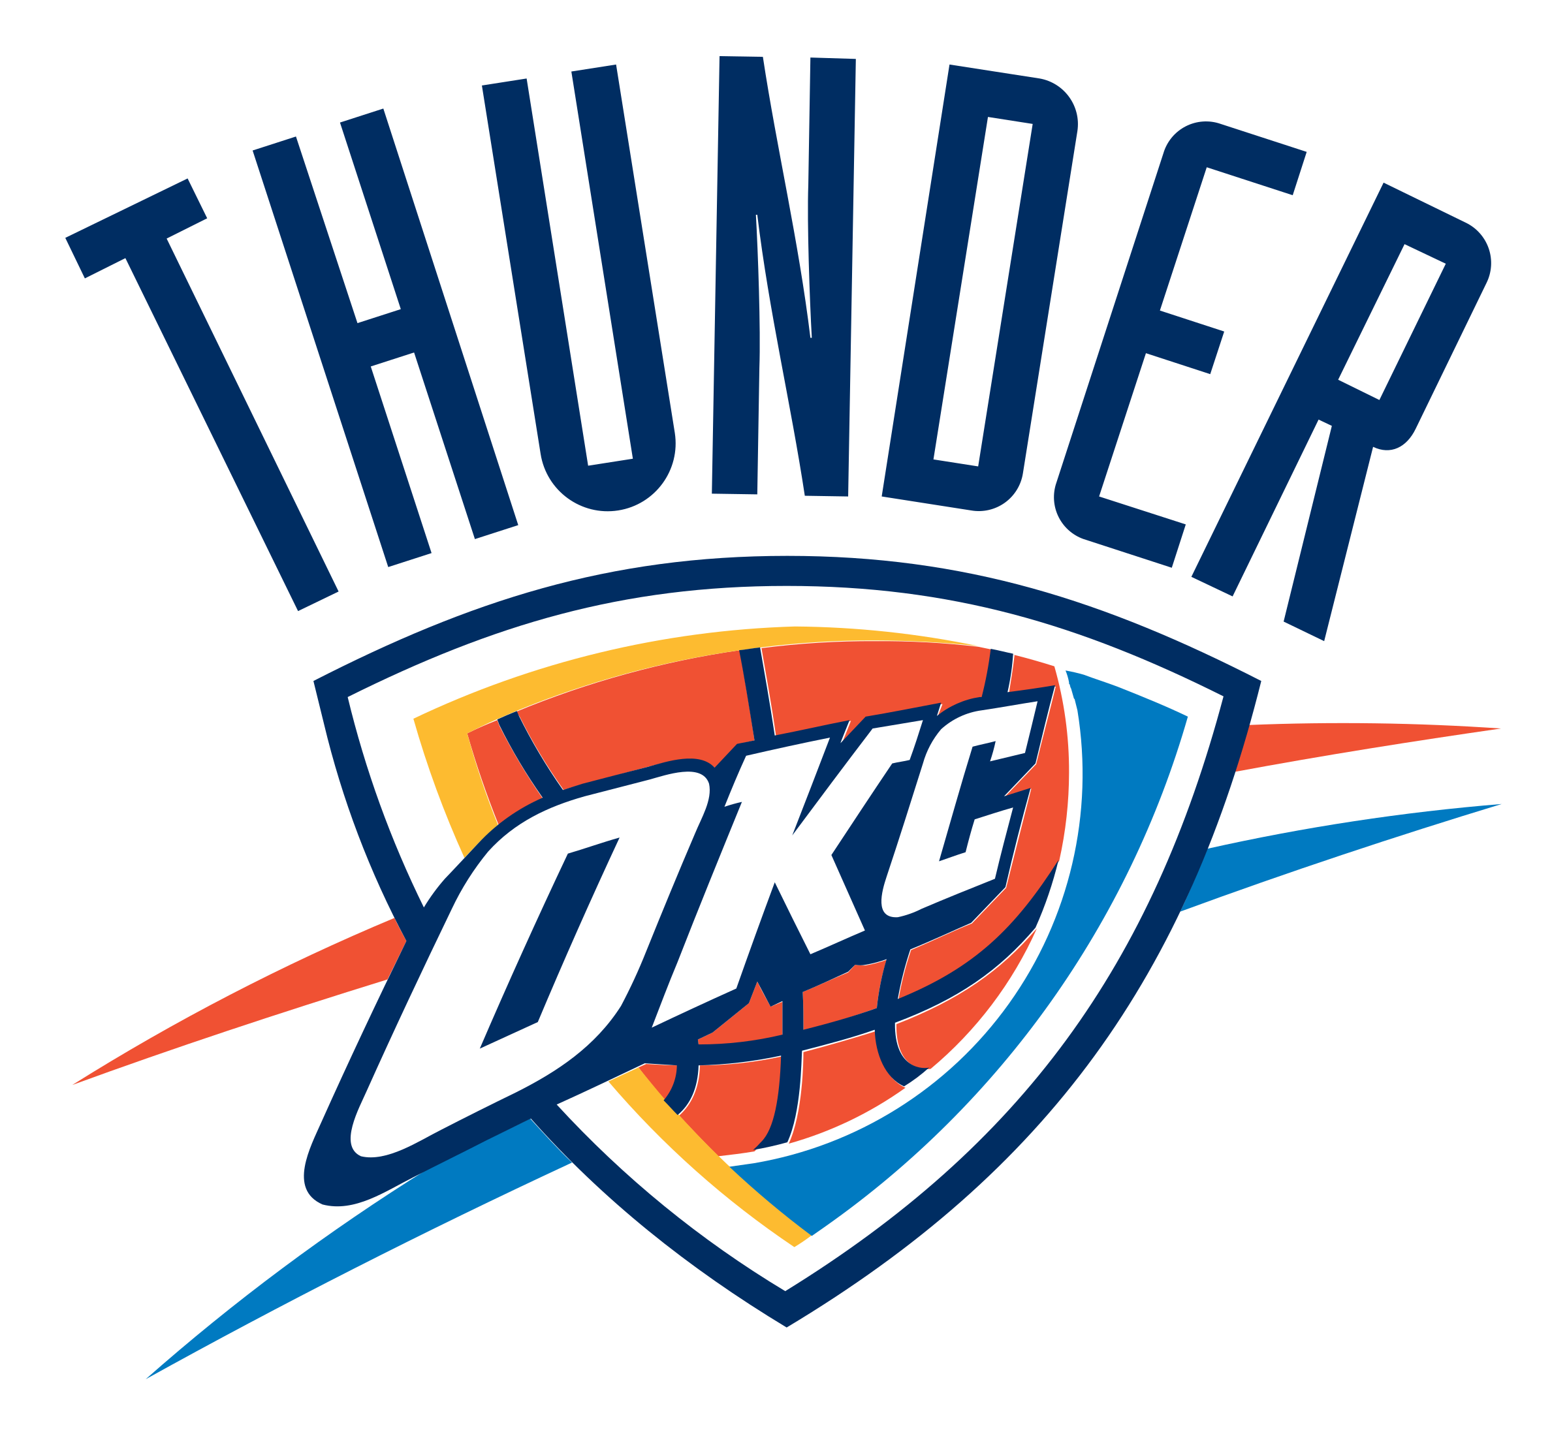
Oklahoma city thunder
Grade: A+ | Rank: #2 | western Conference Rank: #2
The Thunder kept their entire core together, extending Shai Gilgeous-Alexander, Jalen Williams, and Chet Holmgren for $800 million. With Nikola Topic set to debut this year, and nearly all of their roster returning. Oklahoma City enters the season as the team to beat.

Slide 21

Dallas mavericks
Grade: A | Rank: #3 | western Conference Rank: #3
The Mavericks struck gold, getting the opportunity to draft Cooper Flagg, an elite two-way prospect. With Kyrie Irving secured long-term and key extensions, they solidified their core this offseason. Dallas appears ready to compete in the West, a “prove-it” year for GM Nico Harrison’s vison.

Slide 22

Sacramento kings
Grade: A | Rank: #5 | western Conference Rank: #4
The Kings added veteran depth and extended Keegan Murray, maintaining their core of DeMar DeRozan, Zach LaVine, and Domantas Sabonis. Sacramento remains an intriguing team with a mix of experienced vets and young talent,

Slide 23

Denver nuggets
Grade: A | Rank: #7 | western Conference Rank: #5
The Nuggets retooled around Nikola Jokić with veterans, regaining Bruce Brown and adding frontcourt strength in Jonas Valanciunas. They also swapped Michael Porter Jr. for Cameron Johnson. Denver remains firmly in title contention with a more complete roster around their three-time MVP.

Slide 24

Houston rockets
Grade: A | Rank: #8 | western Conference Rank: #6
The Rockets made the biggest splash of the offseason, landing Kevin Durant and Clint Capela while maintaining their young core. Despite Fred VanVleet’s season-ending injury, Houston’s revamped roster puts them firmly in the conversation as a legitimate championship contender.

Slide 25

Golden State warriors
Grade: A- | Rank: #9 | western Conference Rank: #7
The Warriors added Al Horford and managed to retain Jonathan Kuminga. The Western Conference remains stacked, but as long as Stephen Curry leads the way, Golden State will continue to be a threat in any playoff race.

Slide 26

Portland trailblazers
Grade: A- | Rank: #11| western Conference Rank: #8
Portland brought back Damian Lillard and added Jrue Holiday, Despite an early injury to Scoot Henderson and Lillard likely out for the season, the team hopes to build on last year’s 36-win season. Hopefully, they see continued development from Shaedon Sharpe and their other young players.

Slide 27

Los Angelos Lakers
Grade: A- | Rank: #12 | western Conference Rank: #9
The Lakers had a solid offseason, adding pieces while extending Luka Doncic. Luka tends to make life easy for his centers, so grabbing Deandre Ayton for cheap is a win. They also acquired former Defensive Player of the Year Marcus Smart. LeBron has an early injury, but the team looks poised for another strong playoff run.

Slide 28

Memphis grizzlies
Grade: B| Rank: #13 | western Conference Rank: #10
The Grizzlies made a bold move by trading away Desmond Bane, acquiring veteran depth and draft capital while extending Jaren Jackson Jr. Health remains a concern early in the season, with Zach Edey and Brandon Clarke sidelined, and questions linger whether Memphis could have gotten a better player package for Desmond Bane.

Slide 29

Minnesota Timberwolves
Grade: B- | Rank: #16 | western Conference Rank: #11
The Timberwolves maintained their core, keeping Julius Randle and Naz Reid. With Anthony Edwards as a dominant scorer and Rudy Gobert protecting the paint, Minnesota remains a formidable playoff team in the West, despite limited offseason additions.

Slide 30

Phoenix suns
Grade: C+ | Rank: #19 | western Conference Rank: #12
The Suns’ Big Three era came to an end with Kevin Durant and Bradley Beal gone. The fit between Devin Booker and Jalen Green will be interesting to unfold. This roster seems to lack enough talent to compete in the west, especially considering they were the 11th seed last year with KD.

Slide 31

San Antonio spurs
Grade: C+ | Rank: #21 | western Conference Rank: #13
Victor Wembanyama was injured last year, and the only positive to come out of that was that they got lucky in the lottery, jumping up to #2 to draft Dylan Harper. They also added Kornet and Olynk for front-court depth. Depending on how good Wemby got this offseason, the sky is the limit.

Slide 32

New Orleans pelicans
Grade: D | Rank: #27 | western Conference Rank: #14
The Pelicans acquired Jordan Poole and hope for immediate contributions from their rookies. With Herbert Jones extended and Saddiq Bey back healthy, New Orleans projects to be more competitive than last year’s 21-win season, though their ceiling remains moderate.

Slide 33

UTAH JAZZ
Grade: F | Rank: #29 | western Conference Rank: #15
The Jazz are in a rebuilding phase, drafting Ace Bailey while losing Collin Sexton, John Collins, and Jordan Clarkson. With a competitive Western Conference, Utah is focused on development.

